Slide 1
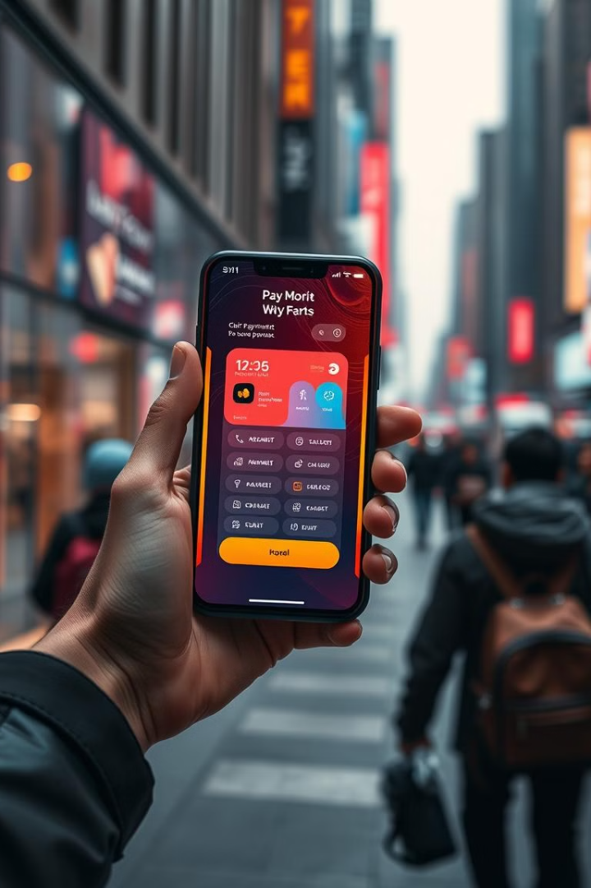

Paytm Clone: MERN-Powered Payments Platform
This presentation explores the development of a Paytm clone using the MERN stack. It highlights key features, technical considerations, and the future roadmap of this project.
by Sahil Thomake

Slide 2
Introduction to Paytm and the Digital Payments Landscape
Paytm: India's Digital Payment Leader
The Rise of Digital Payments
Paytm is a leading digital payments platform in India, offering a wide range of services, including mobile recharge, bill payments, money transfers, and online shopping.
The Indian digital payments landscape has witnessed significant growth, driven by increased smartphone penetration, internet access, and government initiatives promoting digital transactions.

Slide 3
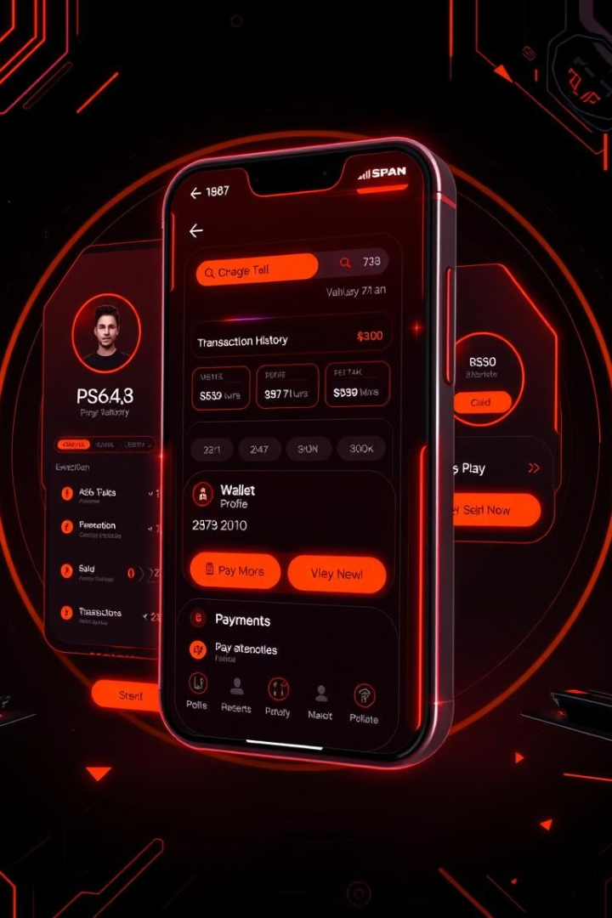
Key Features of the Paytm Clone Application
User Accounts
Digital Wallet
Secure user registration, profile management, and multi-factor authentication for enhanced security.
A user-friendly wallet system for adding funds, managing balance, and making payments.
Bill Payments
Money Transfers
Seamless integration with various utility service providers for bill payments and mobile recharges.
Fast and secure transfer of funds between users via bank accounts or mobile numbers.

Slide 4




Building the Paytm Clone with MERN Stack
MongoDB
1
NoSQL database for storing user data, transaction history, and other critical information.
Express.js
2
Robust Node.js framework for building the backend API to handle requests and manage data.
React.js
3
JavaScript library for building a dynamic and responsive user interface for the web application.
Node.js
4
JavaScript runtime environment for executing the backend logic and handling server-side operations.

Slide 5




User Authentication and Secure Transactions
Secure Login
Data Encryption
Implementing robust user authentication protocols for secure access to user accounts.
Utilizing strong encryption algorithms to protect sensitive user data and transaction information.
Two-Factor Authentication
Adding an extra layer of security by requiring users to provide multiple forms of authentication.

Slide 6




Integrating Payment Gateways and Wallets
Integration
Connecting with popular payment gateways like Razorpay and PayU for seamless transaction processing.
Wallet Support
Enabling users to link their mobile wallets, such as Google Pay and PhonePe, for easy payments.
Security
Ensuring secure and compliant integration of payment gateways and wallets for safe transaction processing.

Slide 7

Scalability and Performance Optimization
1M
10k
Users
Transactions/sec
Scaling the application to handle millions of users and transactions.
Optimizing database queries, caching mechanisms, and load balancing for performance.

Slide 8

Future Roadmap and Conclusion
The Paytm clone project is poised to become a comprehensive and user-friendly digital payments platform. Future development plans include integrating new features, expanding services, and enhancing the user experience for an even more robust and scalable platform.

